Slide 1
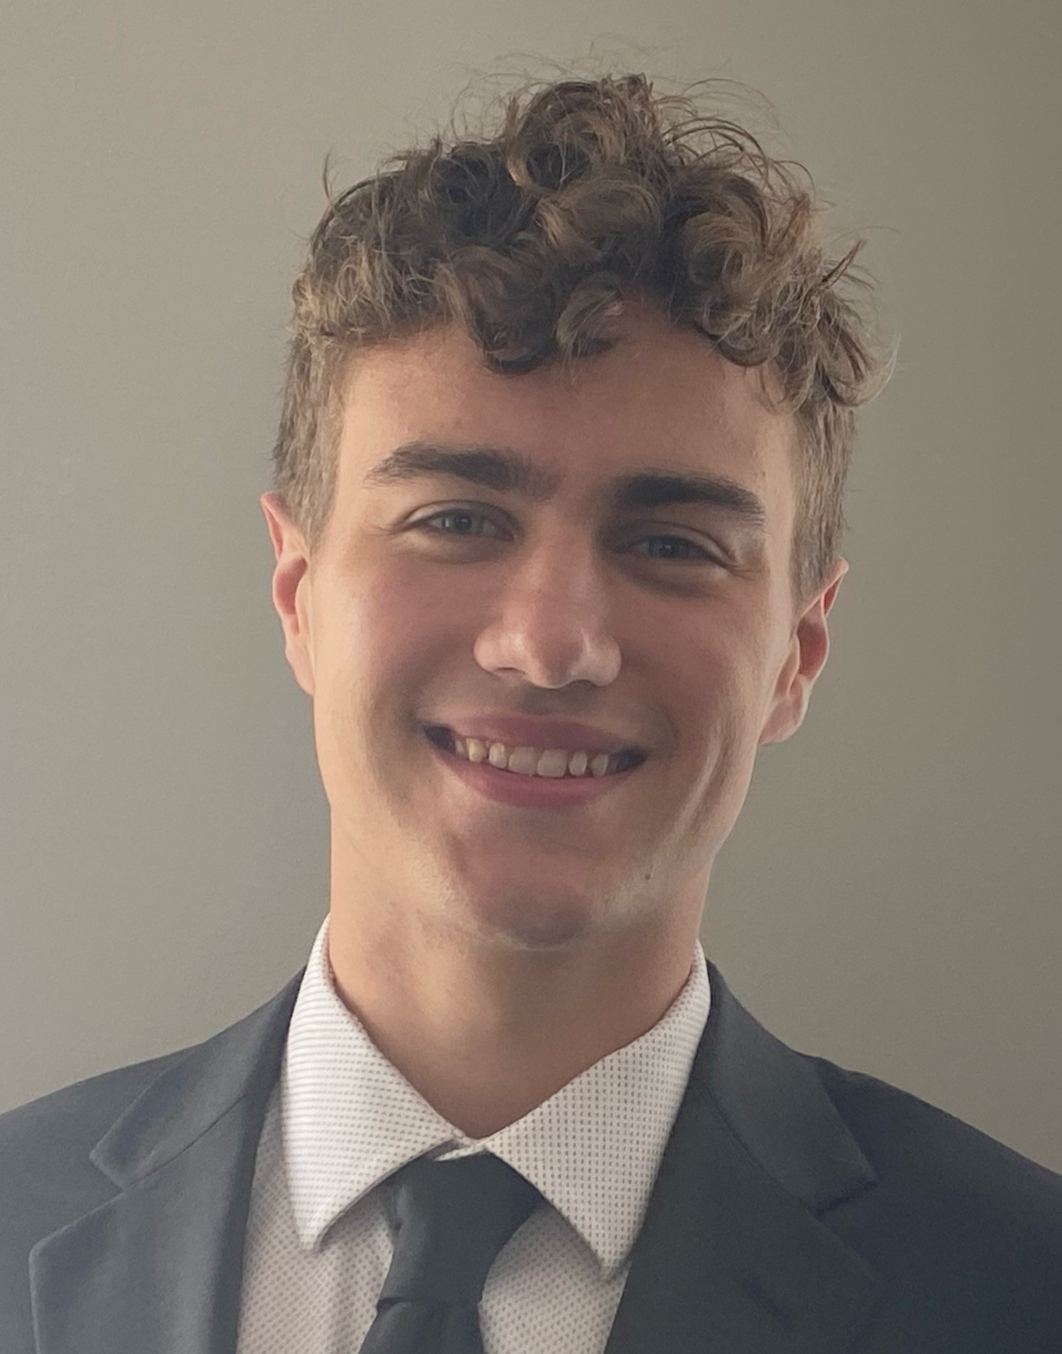
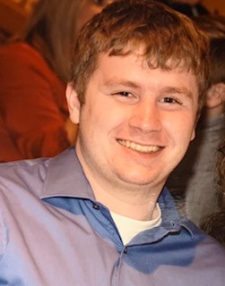

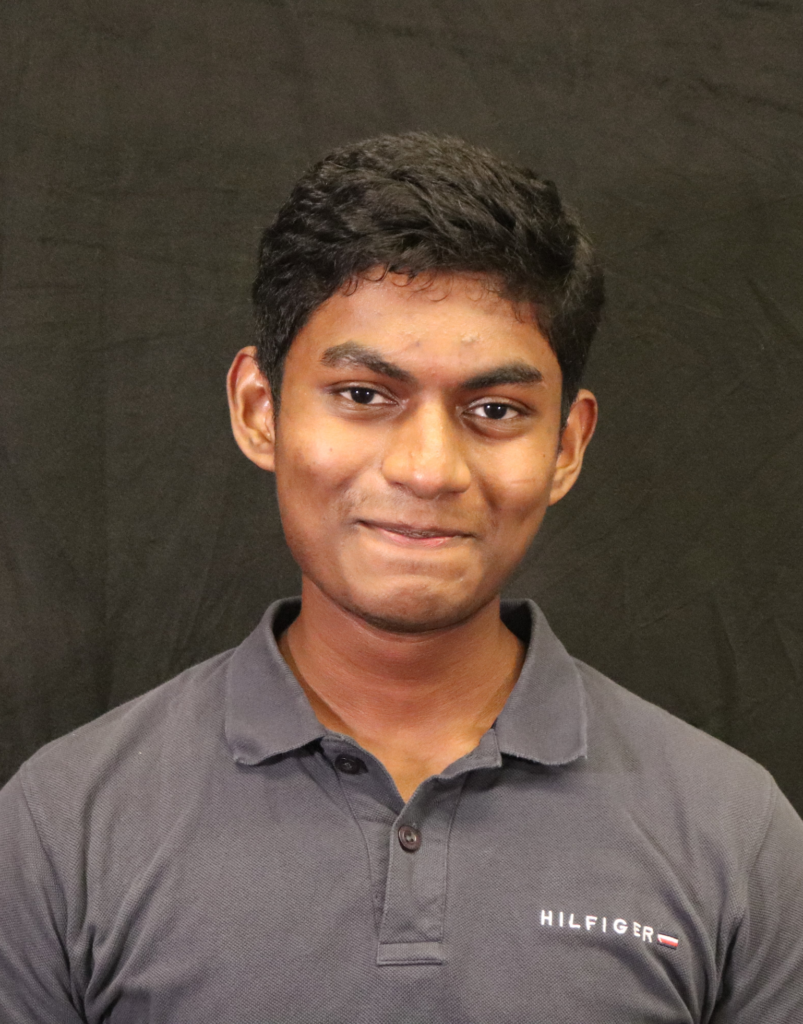

ECE477 MIDTERM DESIGN REVIEW: TEAM 8
ENGINEER’S CHESS
Jack Gardel
Team Leader
Tyson Kline
Systems Engineer
Andy Helton
Hardware Engineer
Bazim Azeem
Software Engineer
Notes:
Bazim

Slide 2
OUTLINE
Project Overview
Major Components
Block Diagram
Packaging Design
Electrical Schematic
PCB Layout
Prototyping Progress
Software Development Status
Project Timeline
Questions
Notes:
Bazim

Slide 3
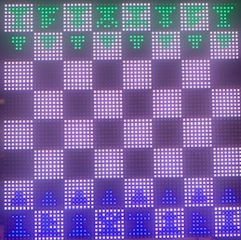
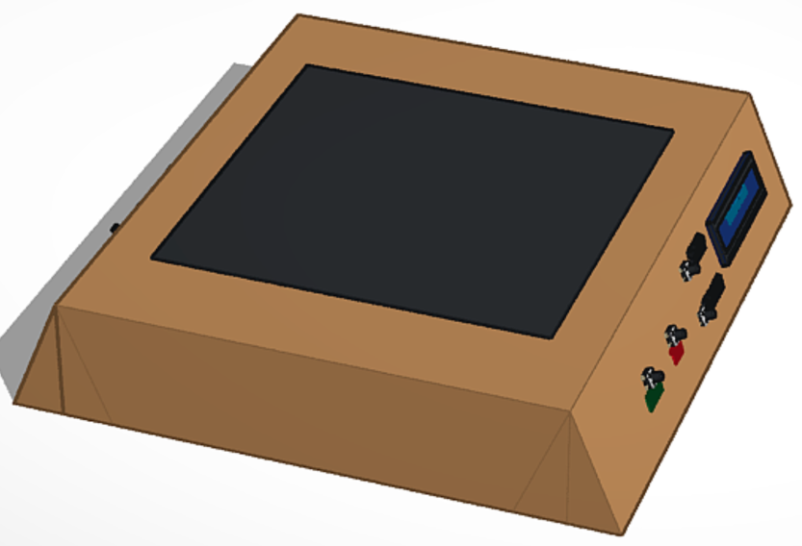
PROJECT OVERVIEW
A voice-activated chess board
Receives voice input and processes into chess move
Displays board on LED matrix
Shows feedback on secondary displays
Notes:
Bazim

Slide 4
PSSCS
Primary Goals
(Software) An ability to pass microphone data stored on the Jetson Nano to a speech recognition algorithm.
(Software) An ability to store and modify data related to game state to efficiently interface with the game logic.
(Hardware) An ability to interface with an OLED feedback display over SPI with the microcontroller.
(Hardware) An ability to interface with a 64x64 LED matrix using a GPIO bit-banging protocol to communicate real-time game state.
(Hardware) An ability to communicate voice commands and Jetson Nano control commands between the microcontroller and Jetson Nano using UART.
Notes:
Jack

Slide 5
PSSCS
Stretch Goals
(Hardware) An ability to regulate power to the microcontroller and other low-voltage peripherals using a voltage regulator circuit instead of a purchased module.
(Software) An ability to preprocess speech data using digital filters before sending it to the speech recognition algorithm/API to improve performance.
(Hardware) An ability to receive speech data on a single board computer using a microphone with an ADC and amplifiers instead of a purchased USB microphone.
Notes:
Jack

Slide 6
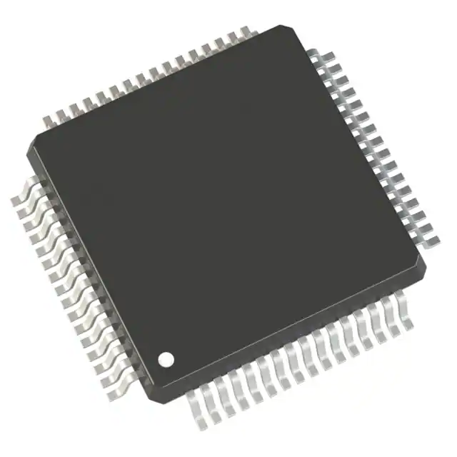
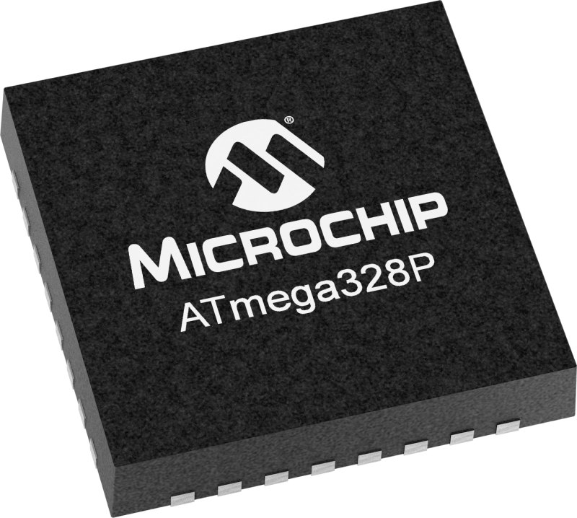
MAJOR COMPONENTS
Microcontroller
Selected: STM32F091
Readily available
48 MHz clock frequency
32 KB flash
SRAM 4096 bytes
8 USART, 2 SPI, 2 I2C, 4 Timers, 10 ADC, 26 GPIO
Free
Alternative: ATmega
20 MHz clock frequency
32 KB flash
SRAM 2048 bytes
1 USART, 2 SPI, 1 I2C, 1 Timers, 8 ADC, 23 GPIO
Notes:
Jack

Slide 7
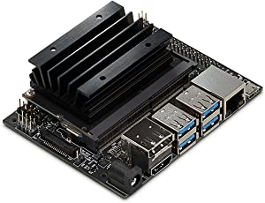
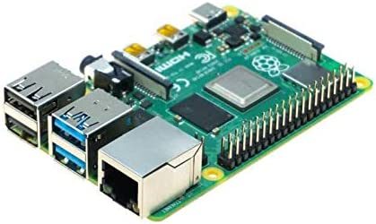
MAJOR COMPONENTS
Single Board Computer
Selected: Jetson Nano
High availability
High manufacturer support
Large heatsink
CPU: 4xA57 @ 1.43 GHz
Alternative: Raspberry Pi
Low availability
High community support
No heatsink; flush with board
CPU: 4xA72 @ 1.5 GHz
Notes:
Jack

Slide 8
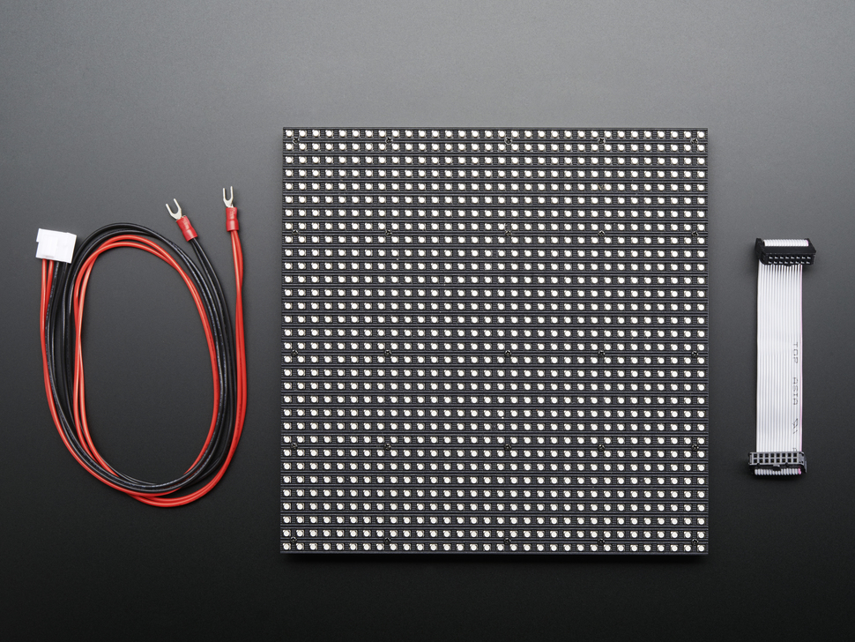
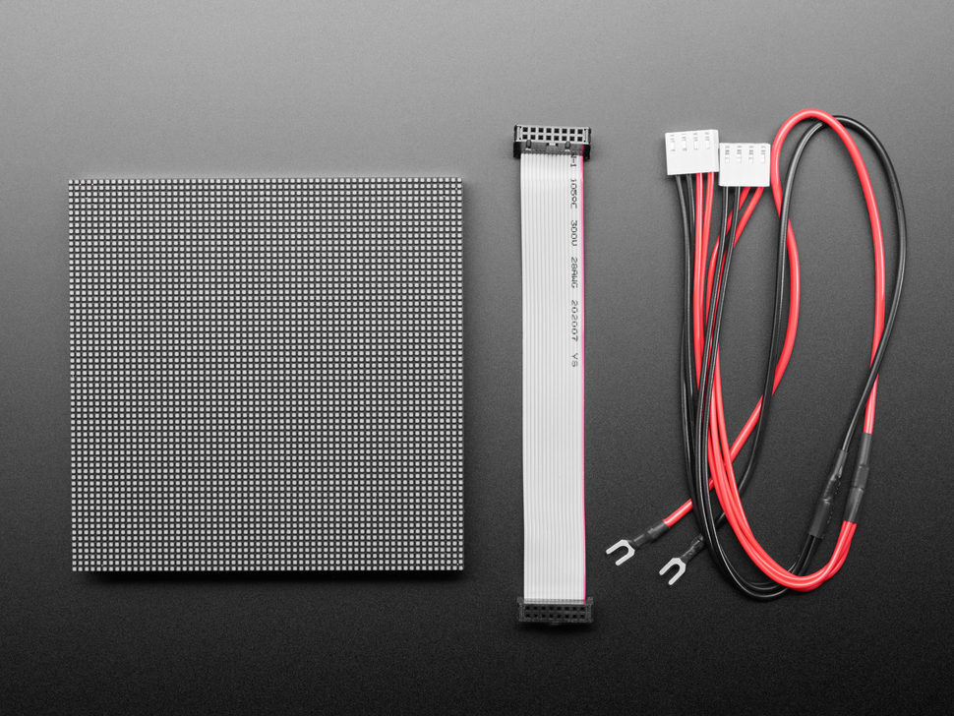
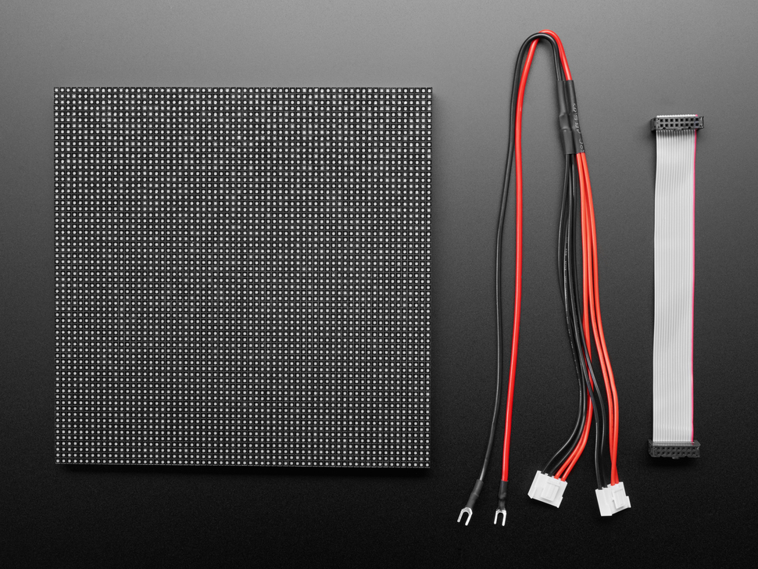
MAJOR COMPONENTS
Main Display
Alternative: 32x32 6mm
190.5mm x 190.5mm
1024 pixels
$39.95
Alternative: 64x64 2mm
128mm x 128mm
4096 pixels
$49.95
Selected: 64x64 3mm
192mm x 192mm
4096 pixels
$59.95
Notes:
Tyson

Slide 9
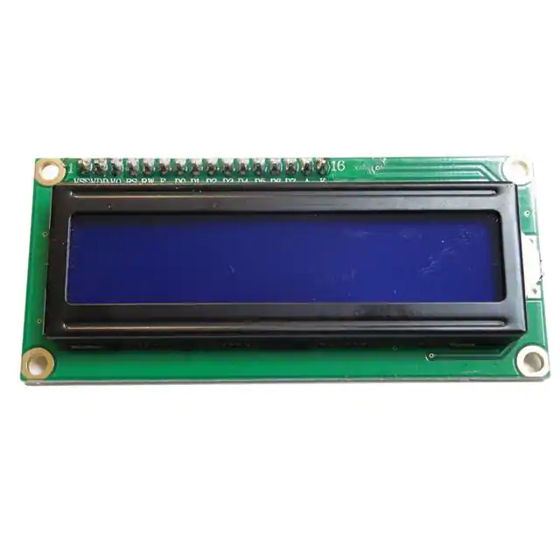
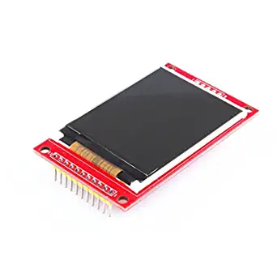
MAJOR COMPONENTS
Secondary Displays
Selected: 1602A-OLED
Readily available
Small width, can be mounted on the side of the chess board
2x16 character rows
3.3V operating voltage
Communicates via SPI
Alternative: 2.2” SPI TFT Module
Readily available
Inappropriate shape
Color TFT display
3.3V operating voltage
Communicated via SPI
Notes:
Bazim

Slide 10
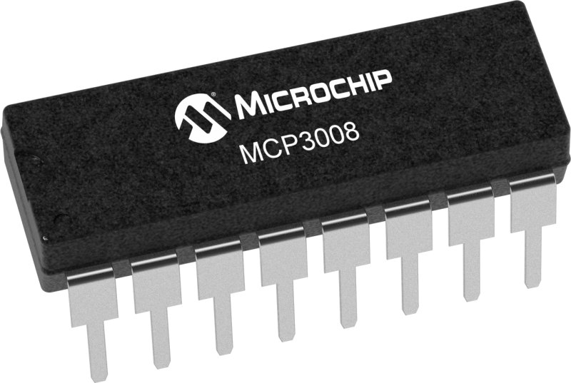
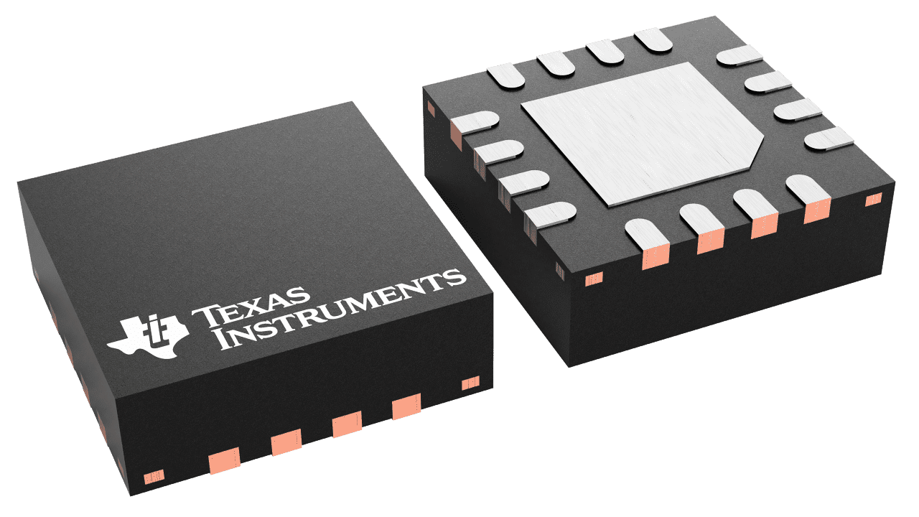
MAJOR COMPONENTS
Analog-to-Digital Converters
Selected: MCP3008
200k samples/s
10 bit resolution
Packages: PDIP, SOIC, TSSOP
$3.15 per unit
Alternative: ADS7038
1k samples/s
12 bit resolution
Packages: WQFN
$7.63 per unit
Notes:
Andy

Slide 11
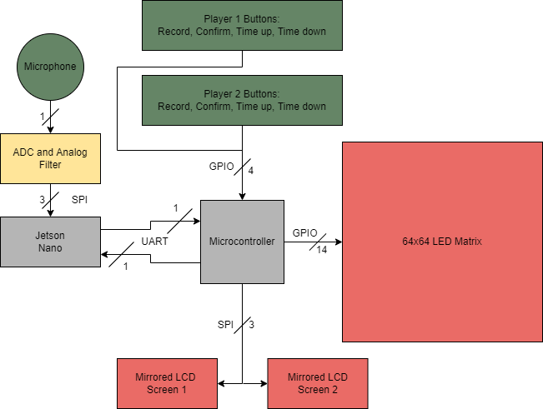
BLOCK DIAGRAM
Notes:
Tyson

Slide 12
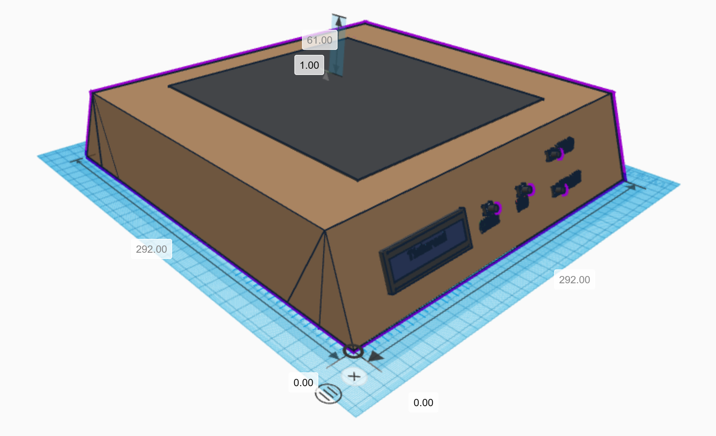
PACKAGING DESIGN
Top Side View
Notes:
Andy

Slide 13
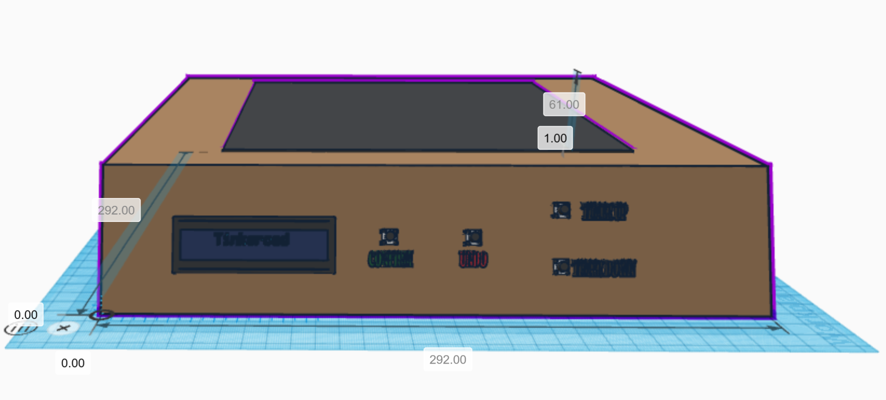
PACKAGING DESIGN
Player View
Notes:
Andy

Slide 14
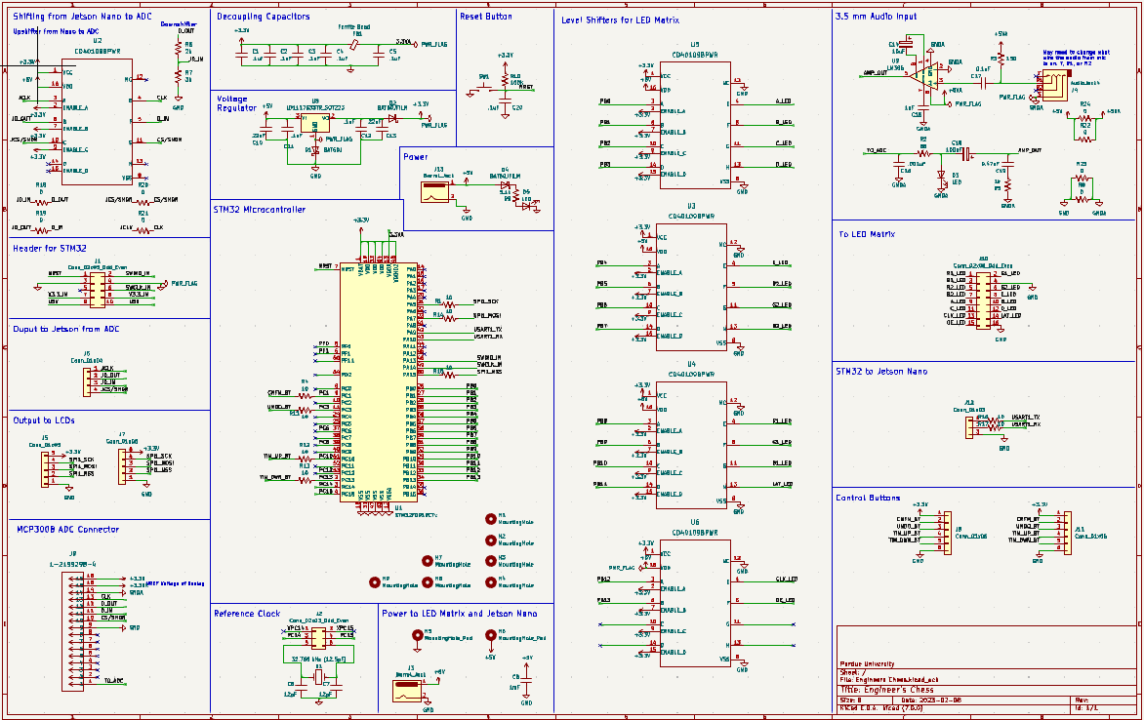
ELECTRICAL SCHEMATIC
Notes:
Tyson

Slide 15
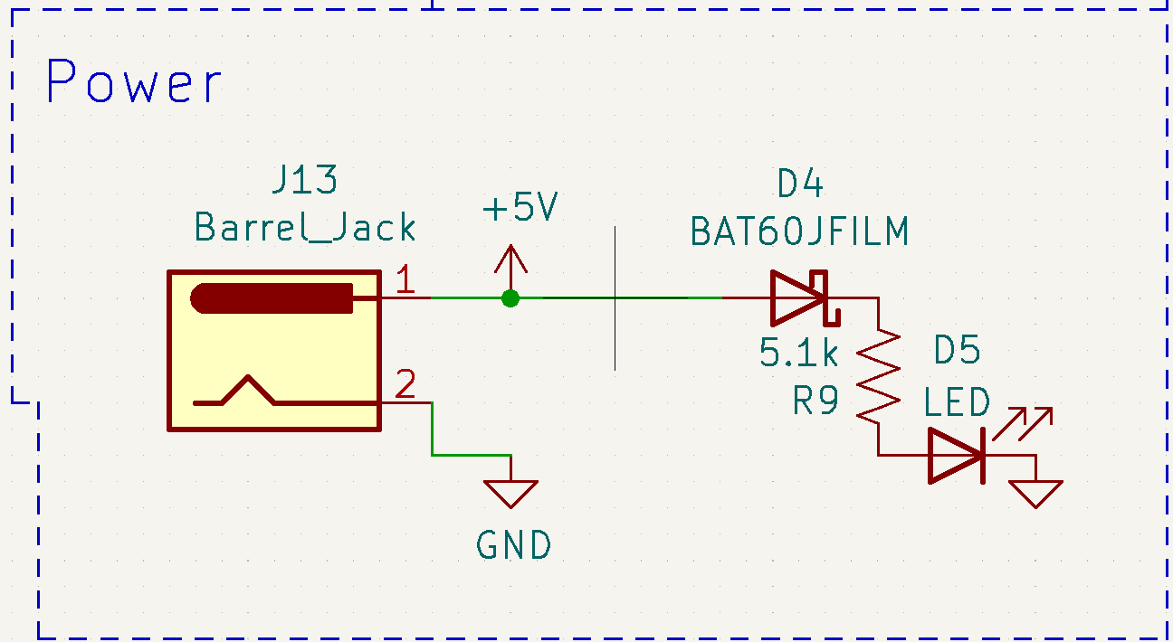
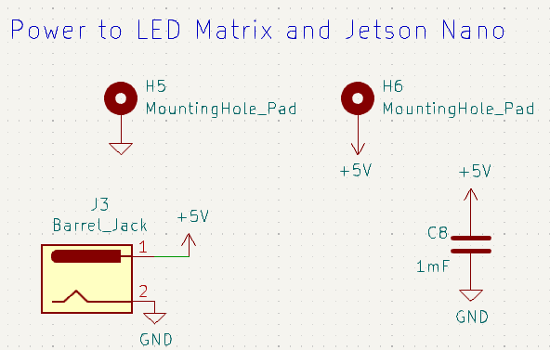
ELECTRICAL SCHEMATIC
Power
Notes:
Tyson

Slide 16
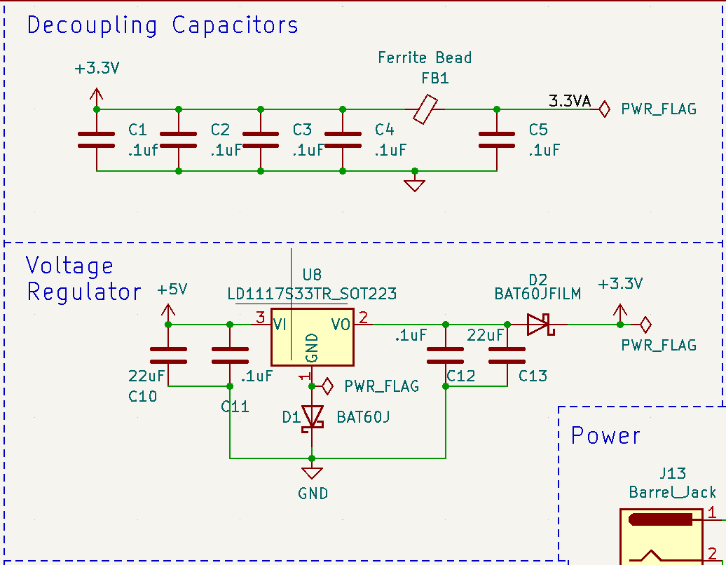
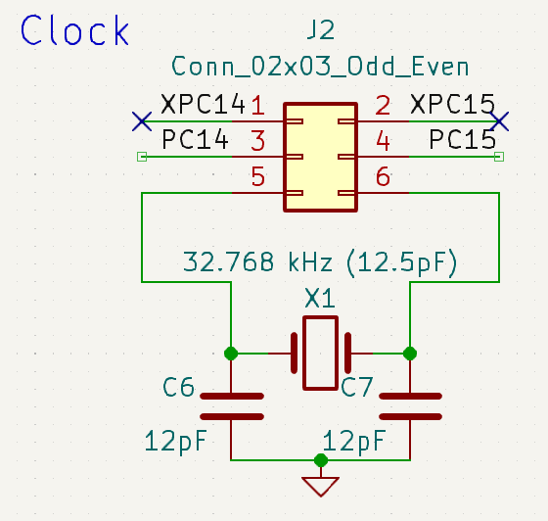
ELECTRICAL SCHEMATIC
Pre-Designed Modules
Modules referenced from the ECE 362 Development Boards
Notes:
Bazim

Slide 17
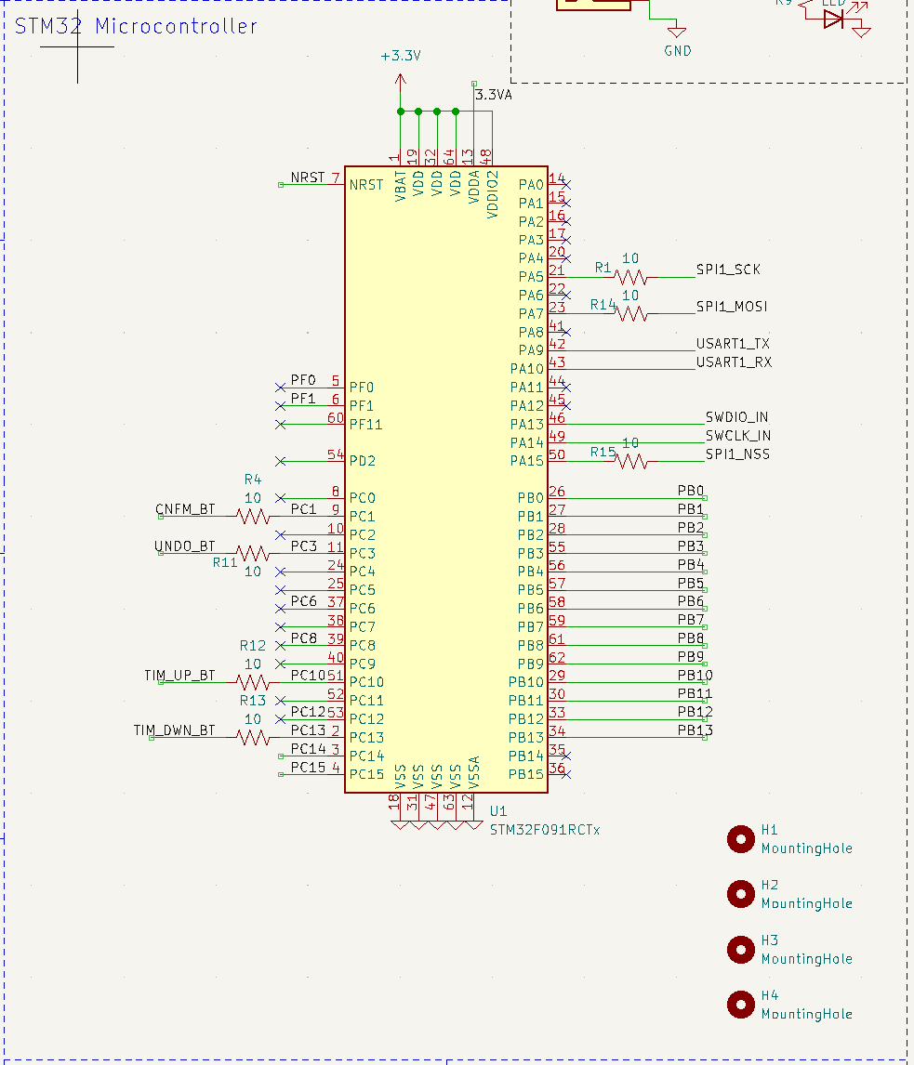
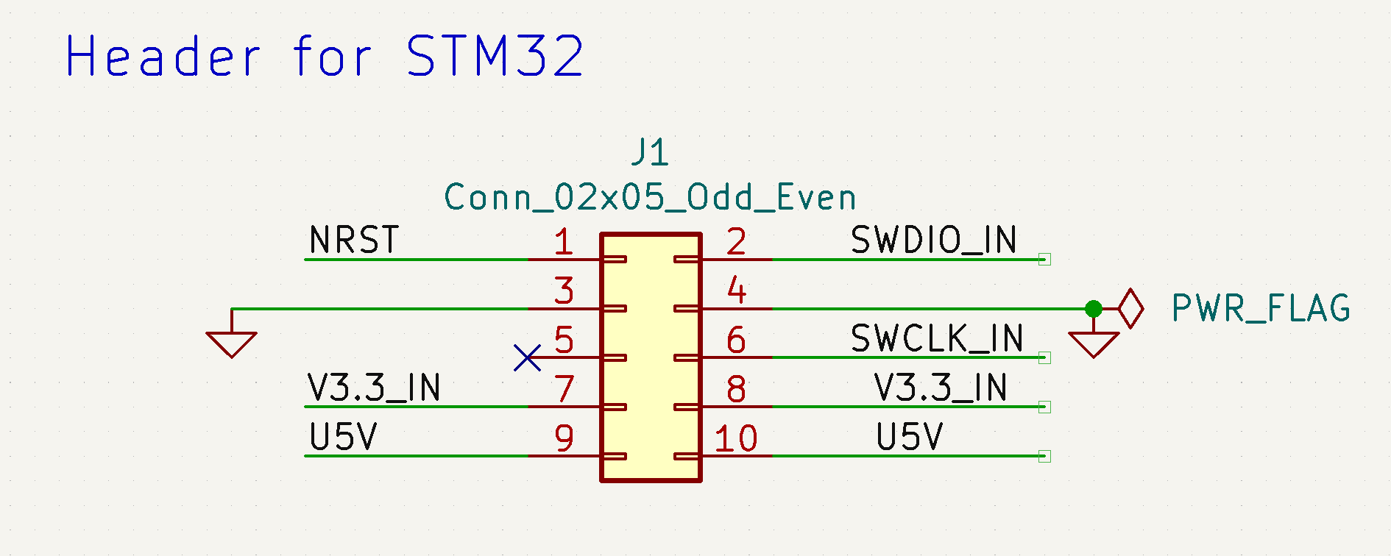
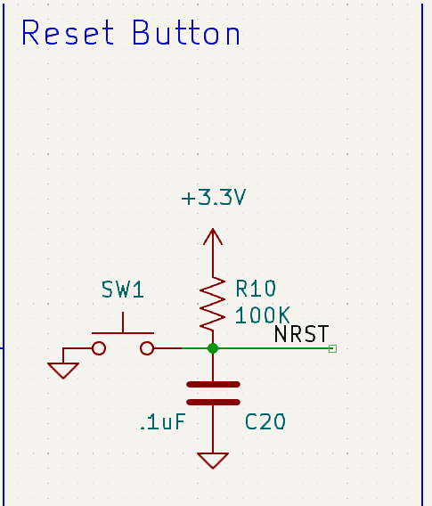
ELECTRICAL SCHEMATIC
STM32 Microcontroller
Notes:
Bazim

Slide 18
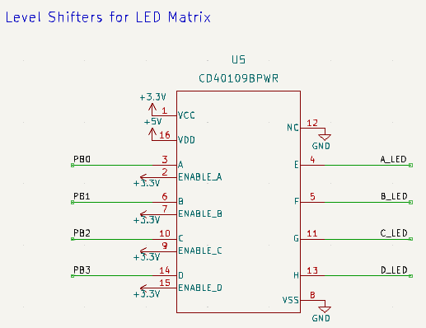
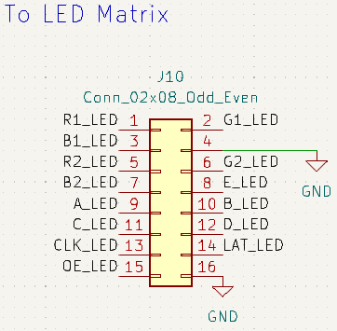
ELECTRICAL SCHEMATIC
LED Display Control
Notes:
Tyson

Slide 19
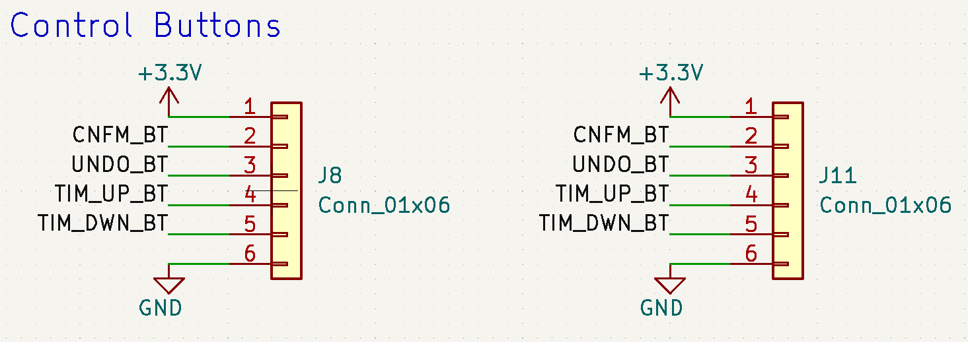
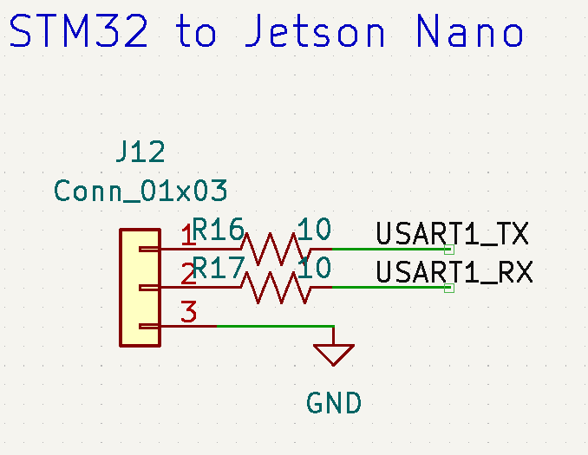
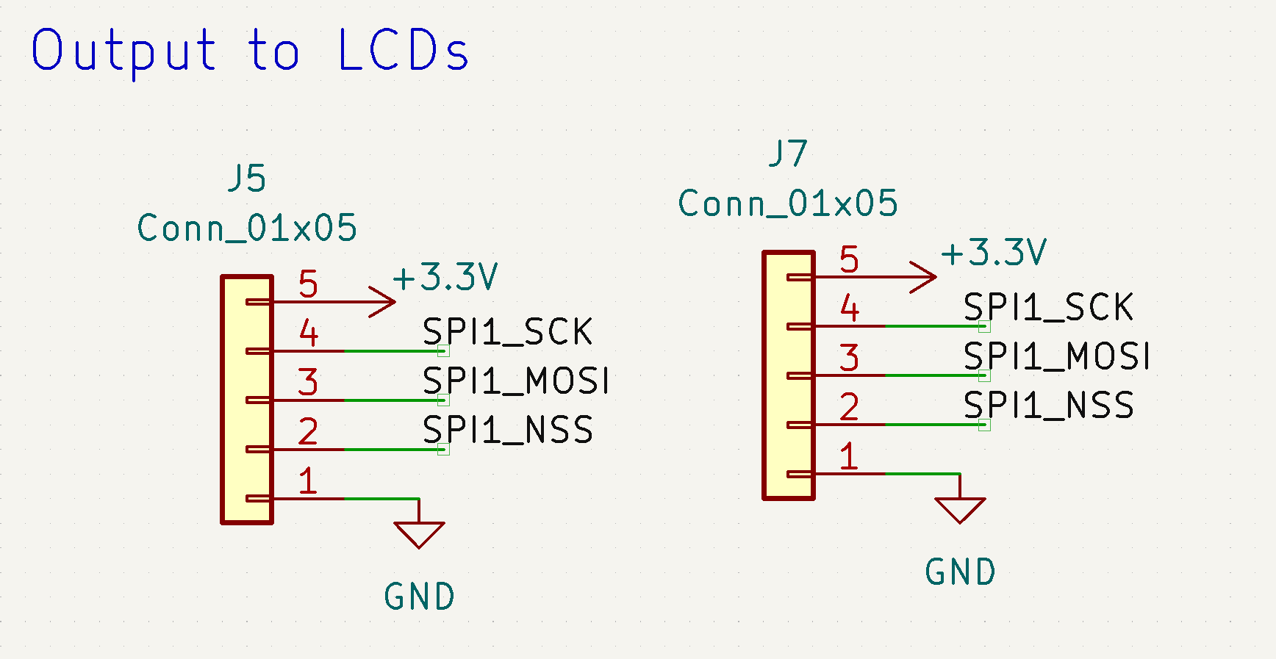
ELECTRICAL SCHEMATIC
Headers
Notes:
Andy

Slide 20
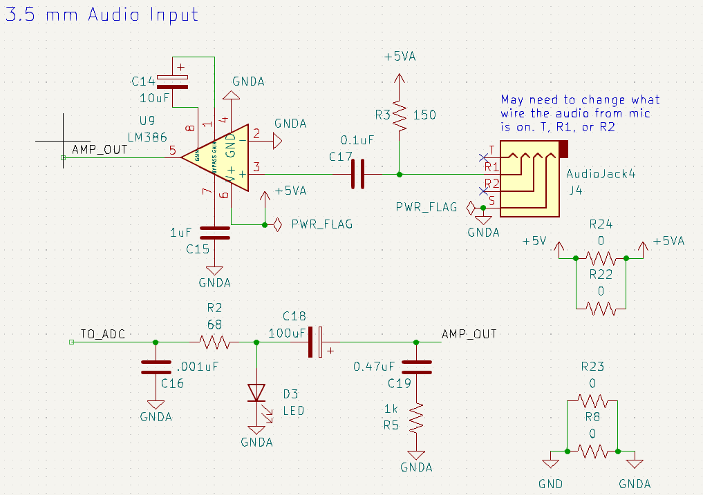
ELECTRICAL SCHEMATIC
Audio Input
Notes:
Andy

Slide 21
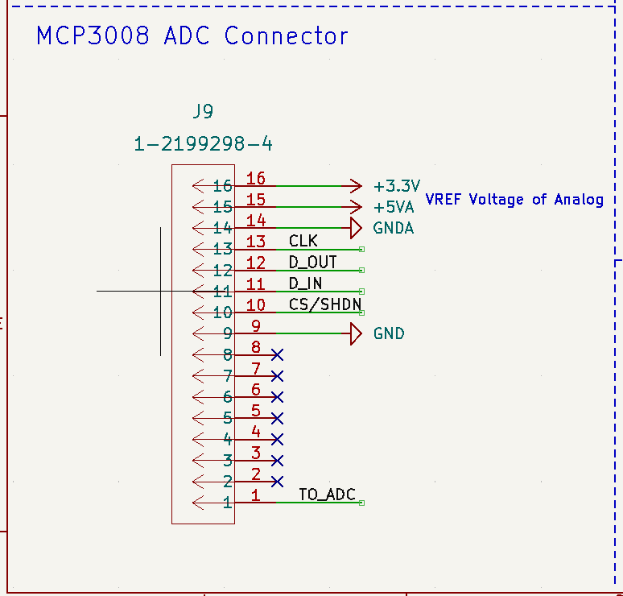
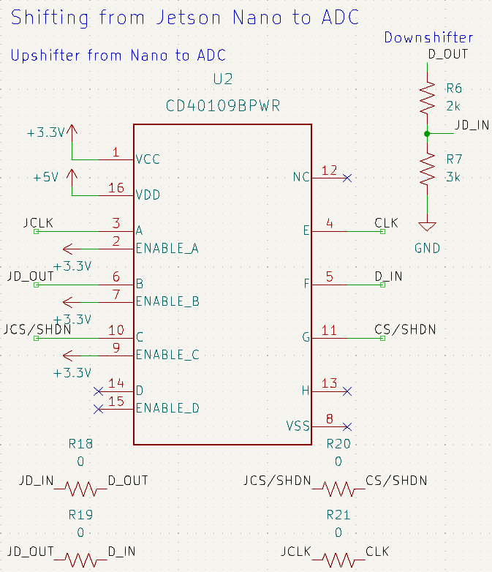
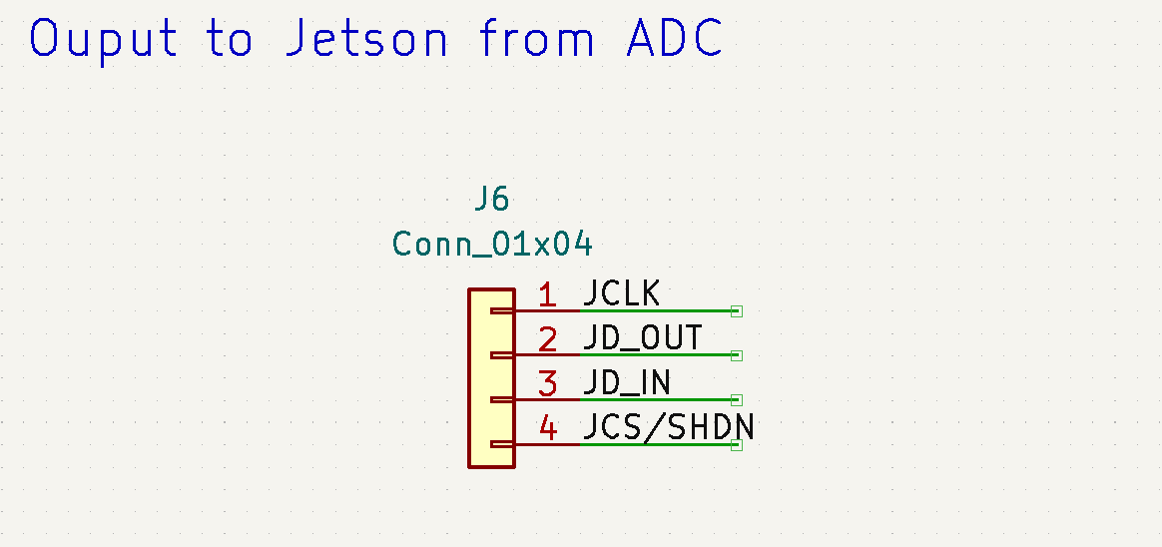
ELECTRICAL SCHEMATIC
ADC Signals
Notes:
Jack

Slide 22
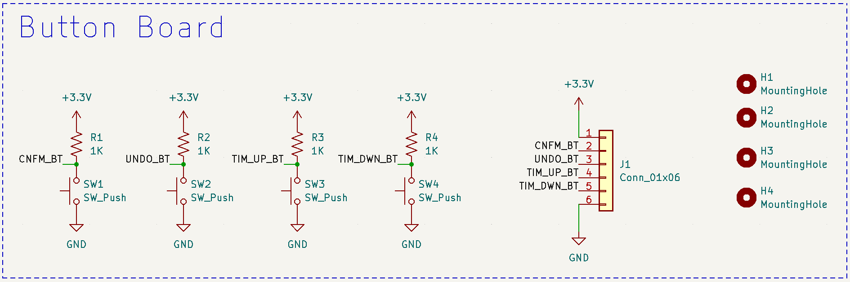
ELECTRICAL SCHEMATIC
Button Board
Notes:
Jack

Slide 23
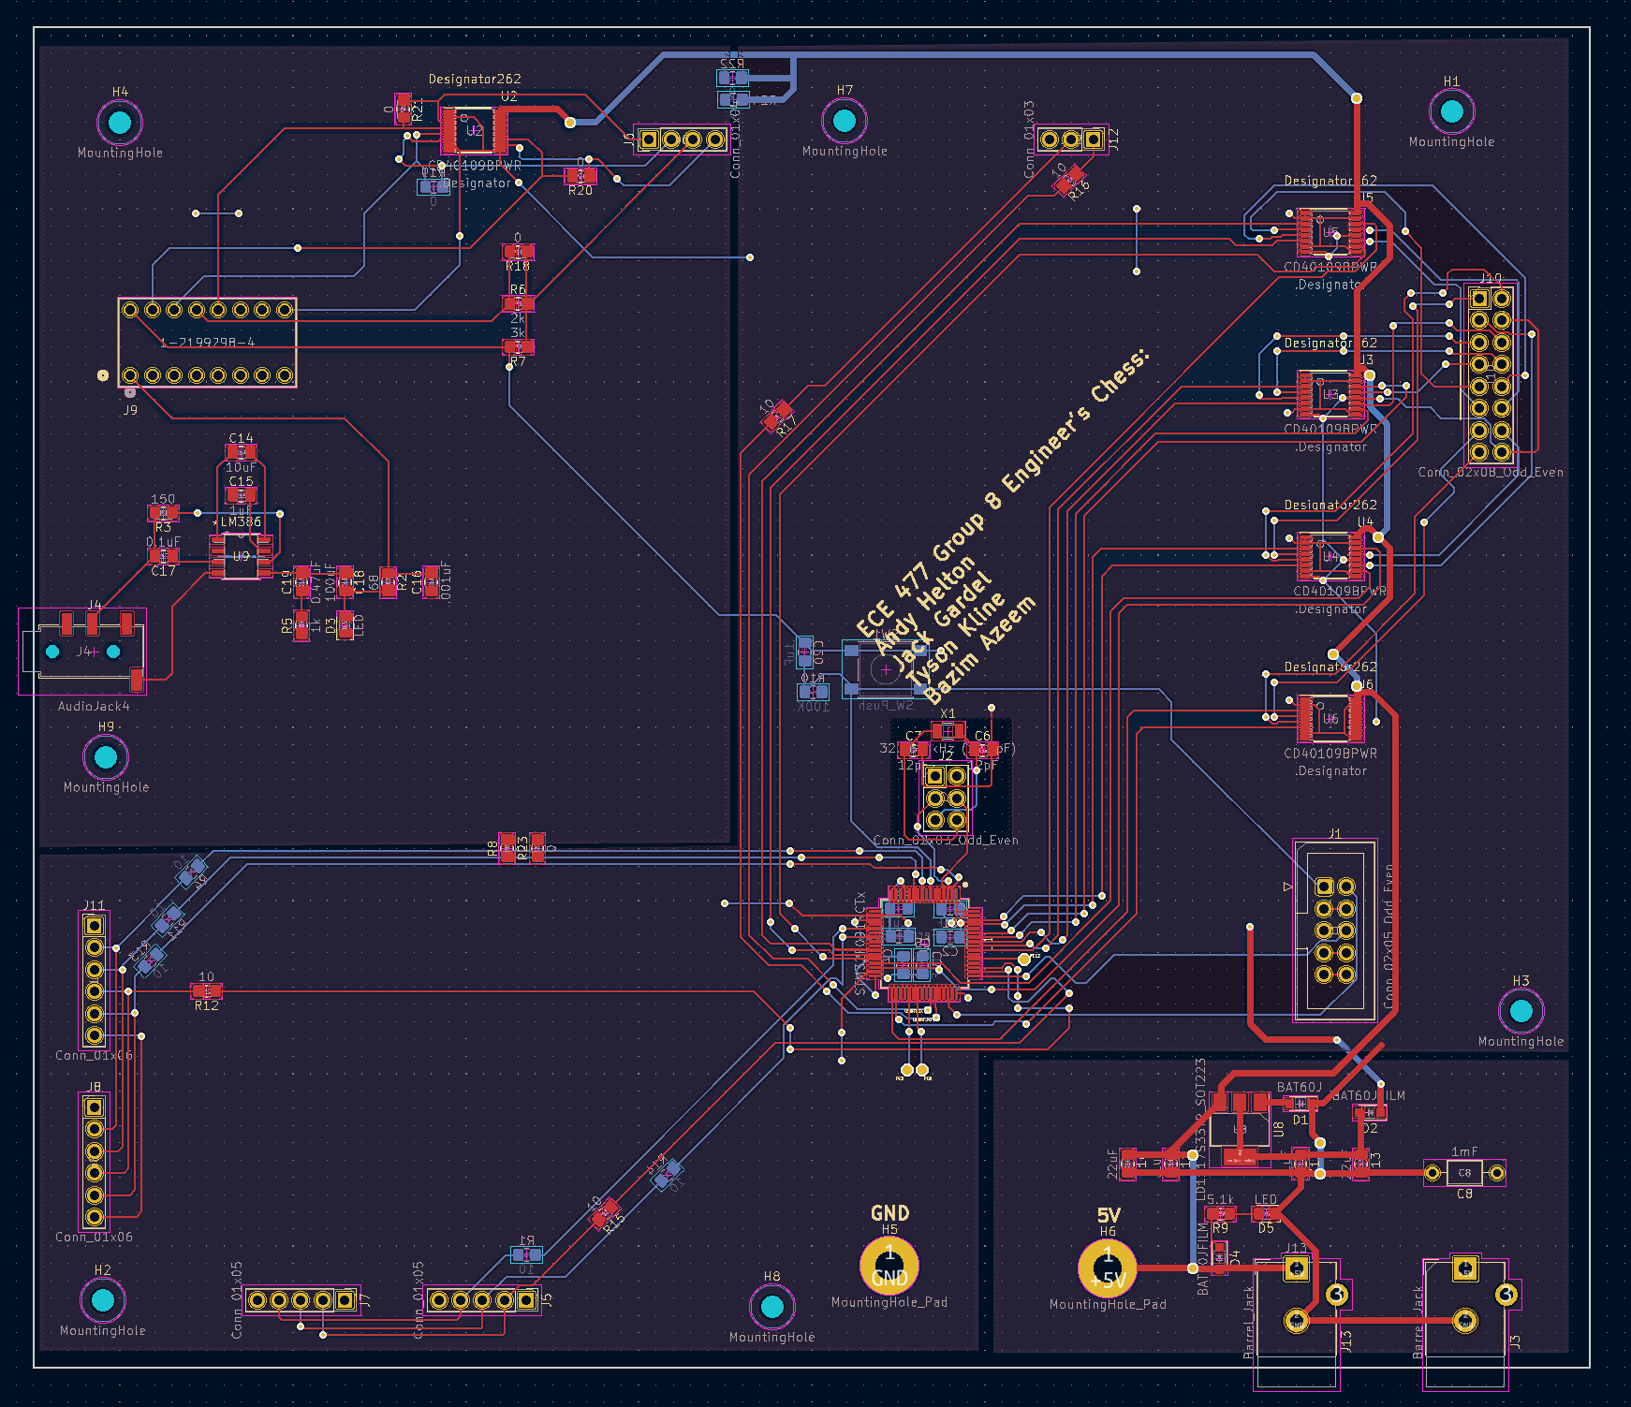
PCB LAYOUT
Full Layout
180mm x 155mm
Power Traces:
30 mils
General Traces:
10 mils
Notes:
Tyson

Slide 24
PCB LAYOUT
Full Layout
hbhv
USART to Nano
Oscillator & Reset
LED Matrix Control
Analog Mic Input &
ADC to Microphone
Programming Header
hbhv
STM32
hbhv
Button Headers
Power & Regulator
hbhv
LCD Headers
Notes:
Tyson

Slide 25
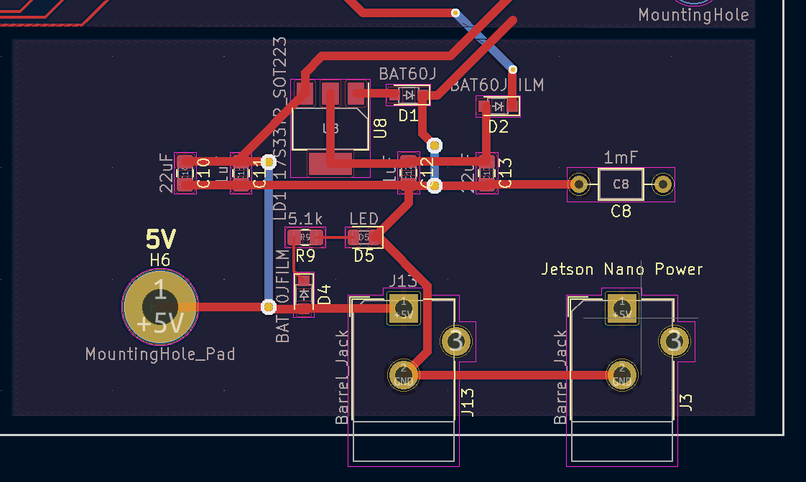
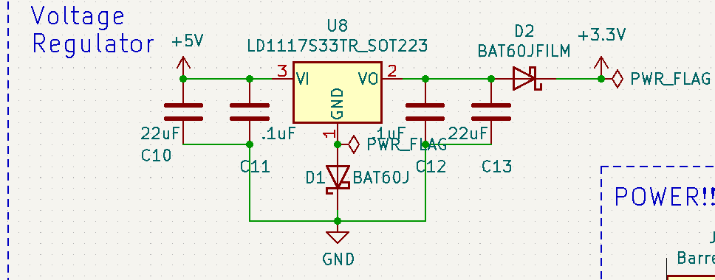
PCB LAYOUT
Power and Regulator
Notes:
Tyson

Slide 26
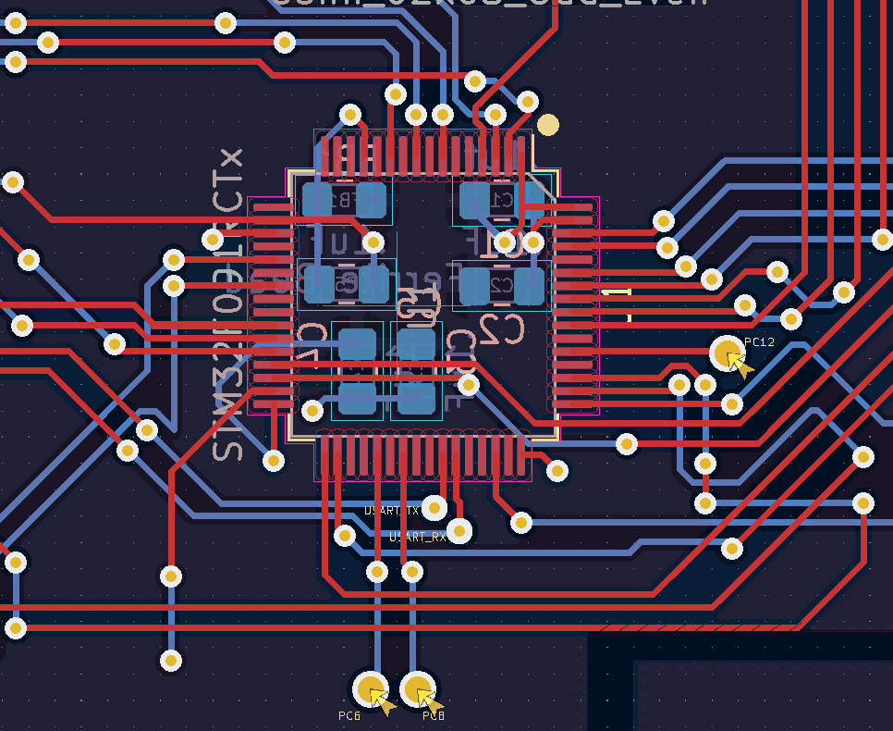
PCB LAYOUT
STM32
Notes:
Andy

Slide 27
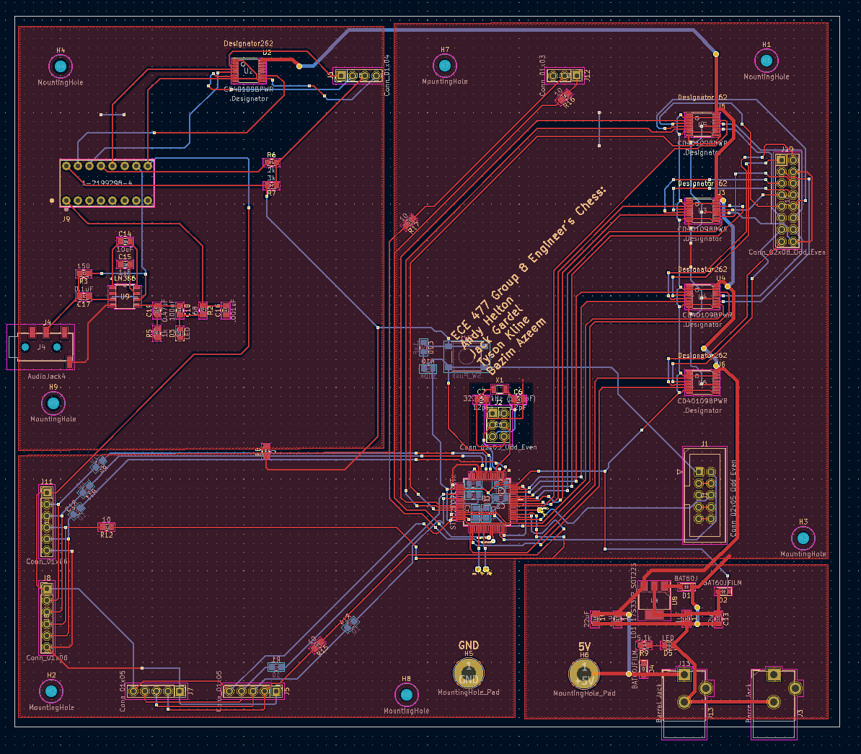
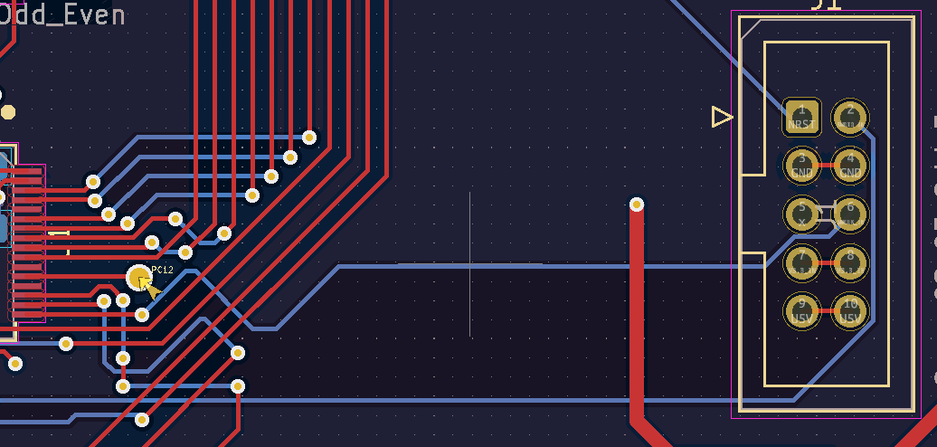
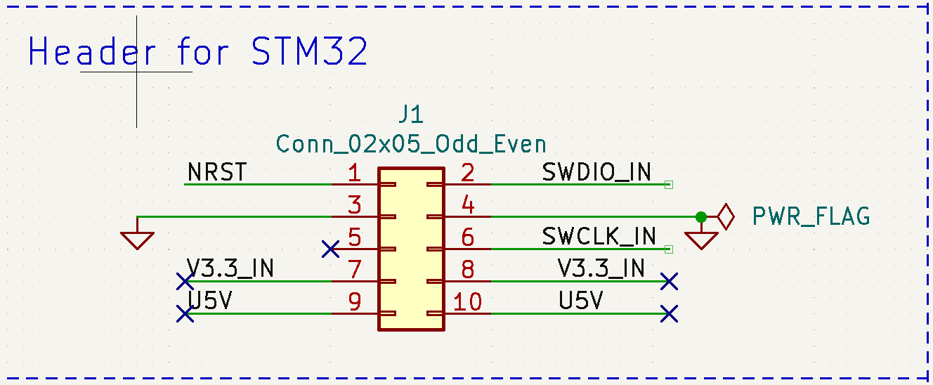
PCB LAYOUT
Programming Header
Notes:
Andy

Slide 28
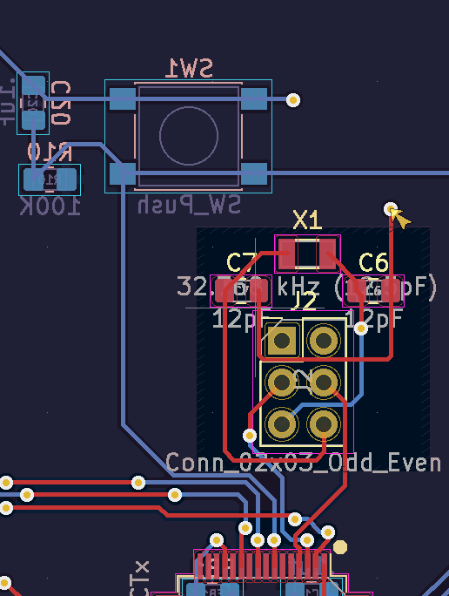
PCB LAYOUT
Oscillator and Reset
Notes:
Andy

Slide 29
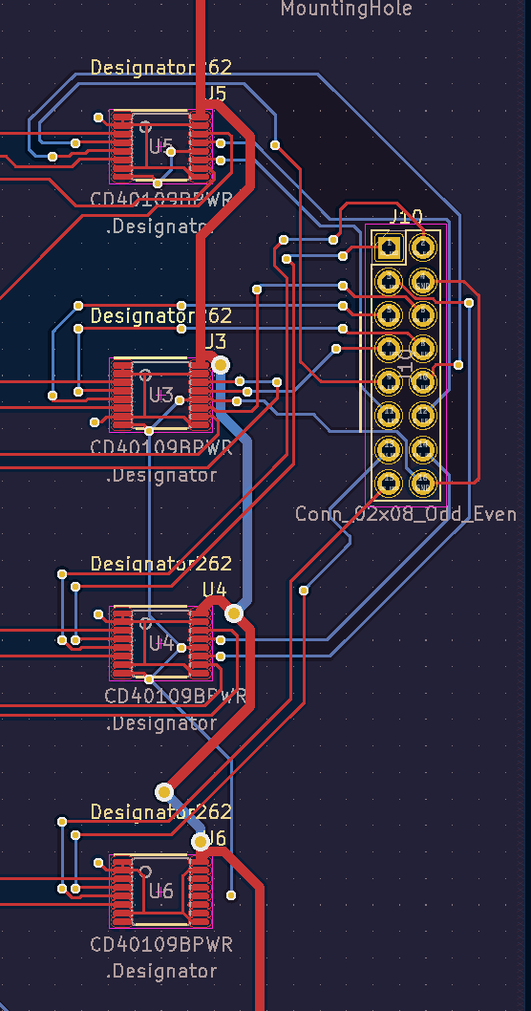
PCB LAYOUT
LED Matrix Control
Notes:
Tyson

Slide 30
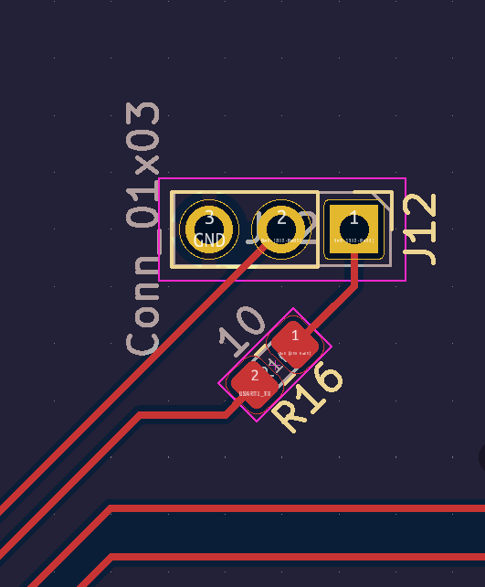
PCB LAYOUT
USART to Nano
Notes:
Tyson

Slide 31
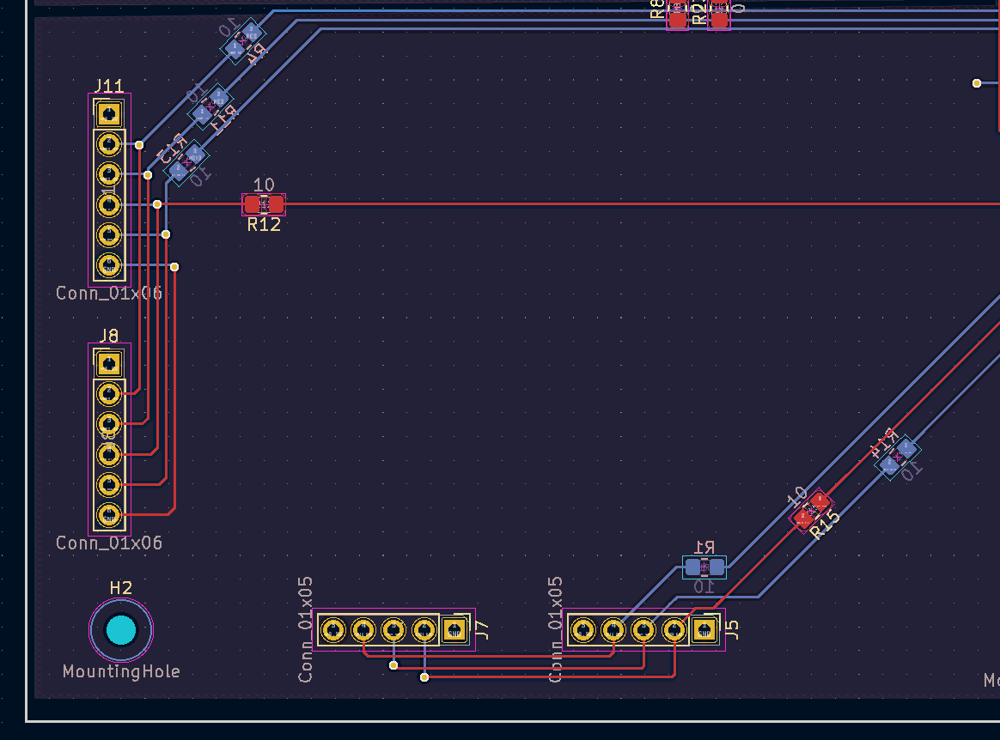
PCB LAYOUT
Button Headers and LCD Headers
Notes:
Andy

Slide 32
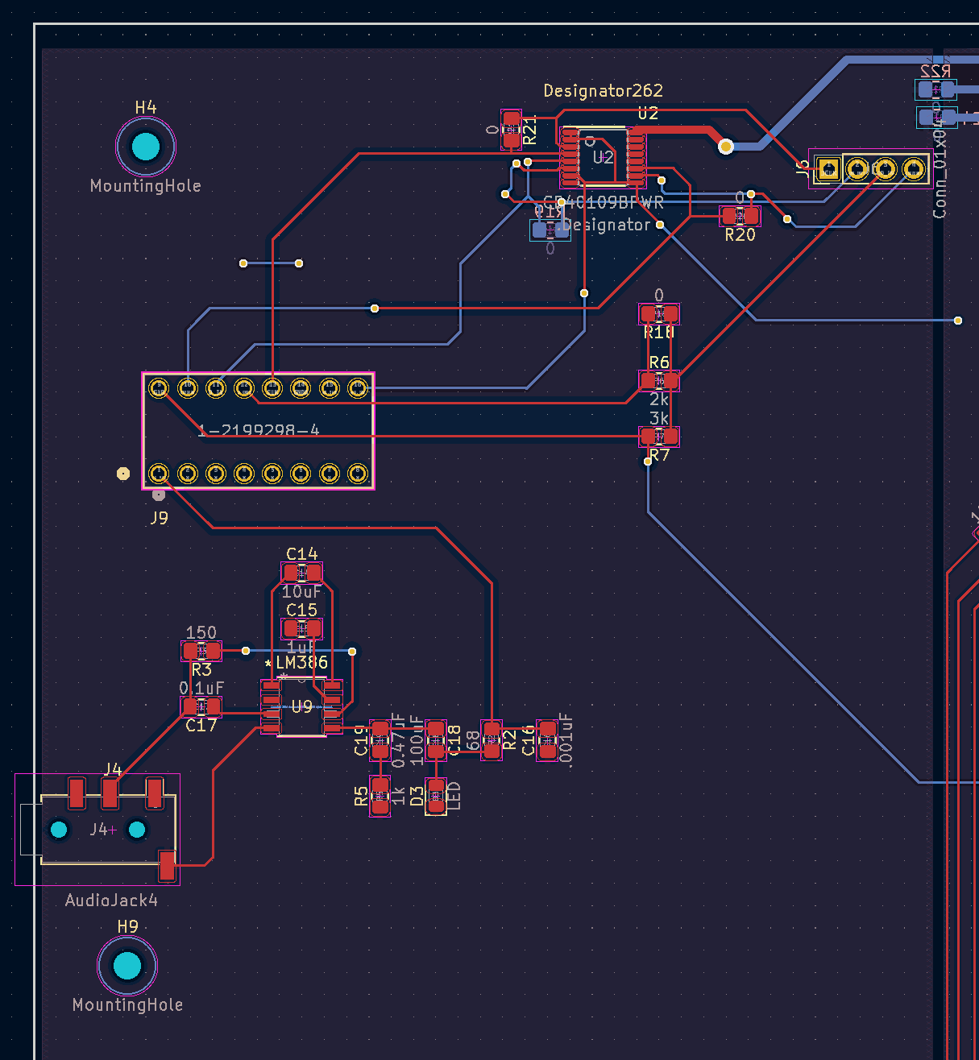
PCB LAYOUT
Analog Mic Input & ADC to Microphone
Notes:
Andy

Slide 33
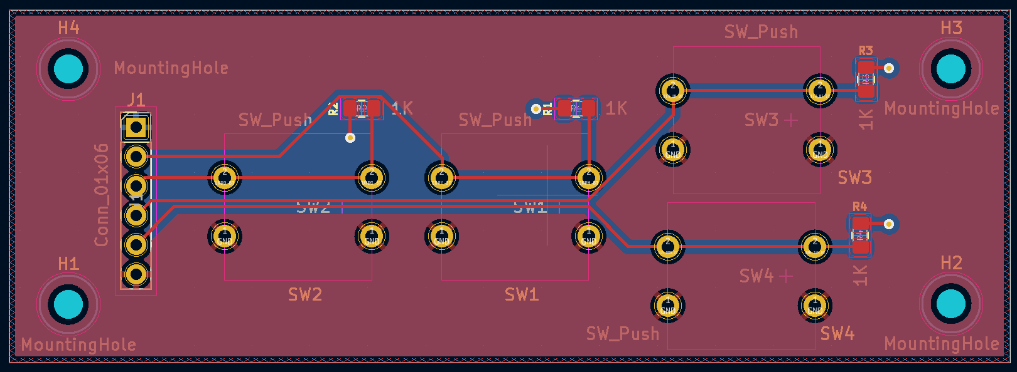
PCB LAYOUT
Button Board
Notes:
Jack

Slide 34


PCB LAYOUT
Footprint Verification
Notes:
Jack

Slide 35

PCB LAYOUT
Footprint Verification
Notes:
Jack

Slide 36

PROTOTYPING PROGRESS
Microcontroller Hardware
Implemented and tested hardware microcontroller features:
USART communication
SPI interface to LCD text display
GPIO interface to LED Matrix
Button controls
Ability to control all features simultaneously
In progress or unimplemented hardware microcontroller features:
None
Notes:
Tyson

Slide 37

PROTOTYPING PROGRESS
Microcontroller Software
Implemented and tested microcontroller software features:
Initial State
Timer Setting/Switching
Correct display of board pieces to LED matrix
In progress or unimplemented microcontroller software features:
Record move signal
Startup/Shutdown
Move feedback
Complex moves
Notes:
Tyson

Slide 38

PROTOTYPING PROGRESS
Jetson Nano to STM32 Protocol Specification
Protocol is fully functional on the Jetson Nano side, partially functional on the STM32 side
Both devices can send and receive over UART reliably
Notes:
Jack

Slide 39


PROTOTYPING PROGRESS
Jetson Nano to ADC Interface
The specification for the SPI interface has been matched to a program on the Jetson Nano
The test program can successfully poll channel 1 on the ADC continuously
Notes:
Jack

Slide 40


PROTOTYPING PROGRESS
3.5mm Microphone Input
Confirmed 3.5 mm microphone input and the gain before sending to the ADC
Notes:
Andy

Slide 41

SOFTWARE DEVELOPMENT STATUS
Major Components
Game Logic: In development
Voice Processing: In development
Basic I/O (Microcontroller): In development
Notes:
Bazim

Slide 42

SOFTWARE DEVELOPMENT STATUS
Game Logic and Voice Processing Components
Implemented on the Jetson Nano.
Game Logic:
Uses python-chess.
Keeps track of the state of the board.
A main loop checking for is an end condition is hit.
Verifies move legality.
Sends feedback and board state to the microcontroller.
Voice Processing:
Receives microphone input.
Converts to text using Picovoice.
Converts the text into a chess move in universal chess interface format
Notes:
Bazim

Slide 43

SOFTWARE DEVELOPMENT STATUS
Basic I/O (Microcontroller) Component
Handles all input and output on the microcontroller. This includes:
Writing to LED matrix
Writing to Feedback displays
Receiving from Jetson Nano
Sending to Jetson Nano
Receiving button input.
Notes:
Bazim

Slide 44

PROJECT TIMELINE
Notes:
Bazim

Slide 45
3D PRINTING
Questions?

